Slide 1

Stop manually publishing your PowerShell modules
Automate it in 2 minutes!
Daniel Schroeder
@deadlydog
1 / 15

Slide 2
Keep this here and replace it with the update sponsor image that will be sent out the week prior to summit

Slide 3

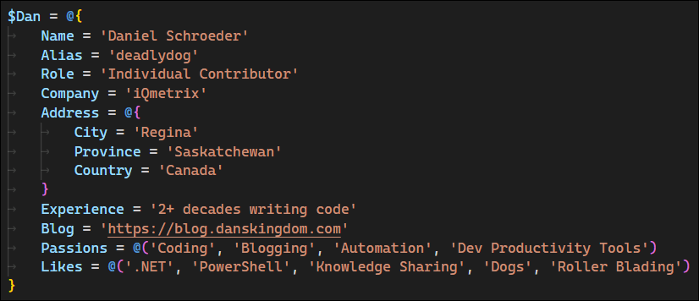
About Dan
Notes:
- @deadlydog
- Individual Contributor at iQmetrix
- Writing software for over 2 decades
- Blogging for over a decade: https://blog.danskingdom.com
- Passionate about automation and developer productivity tools

Slide 4
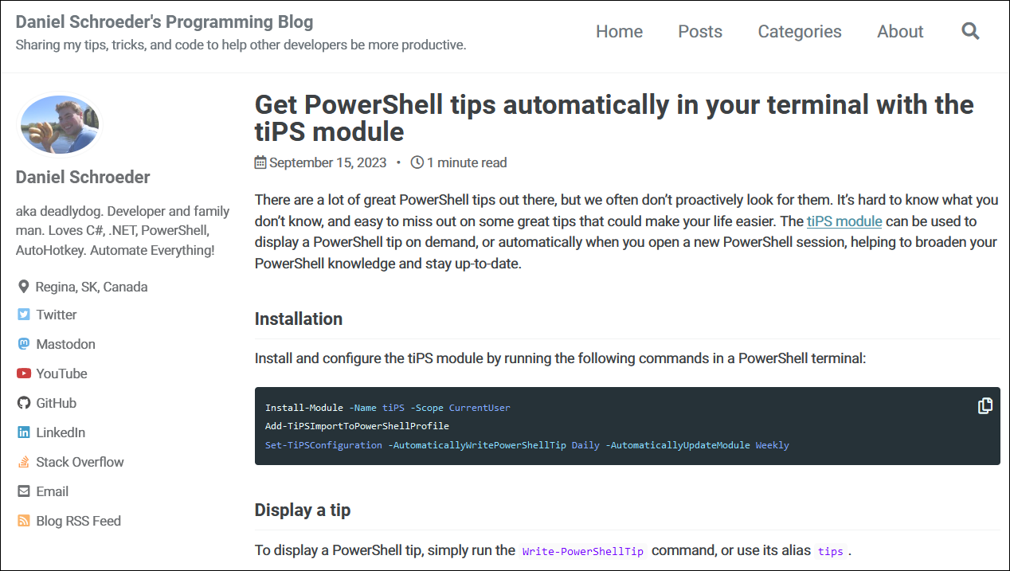
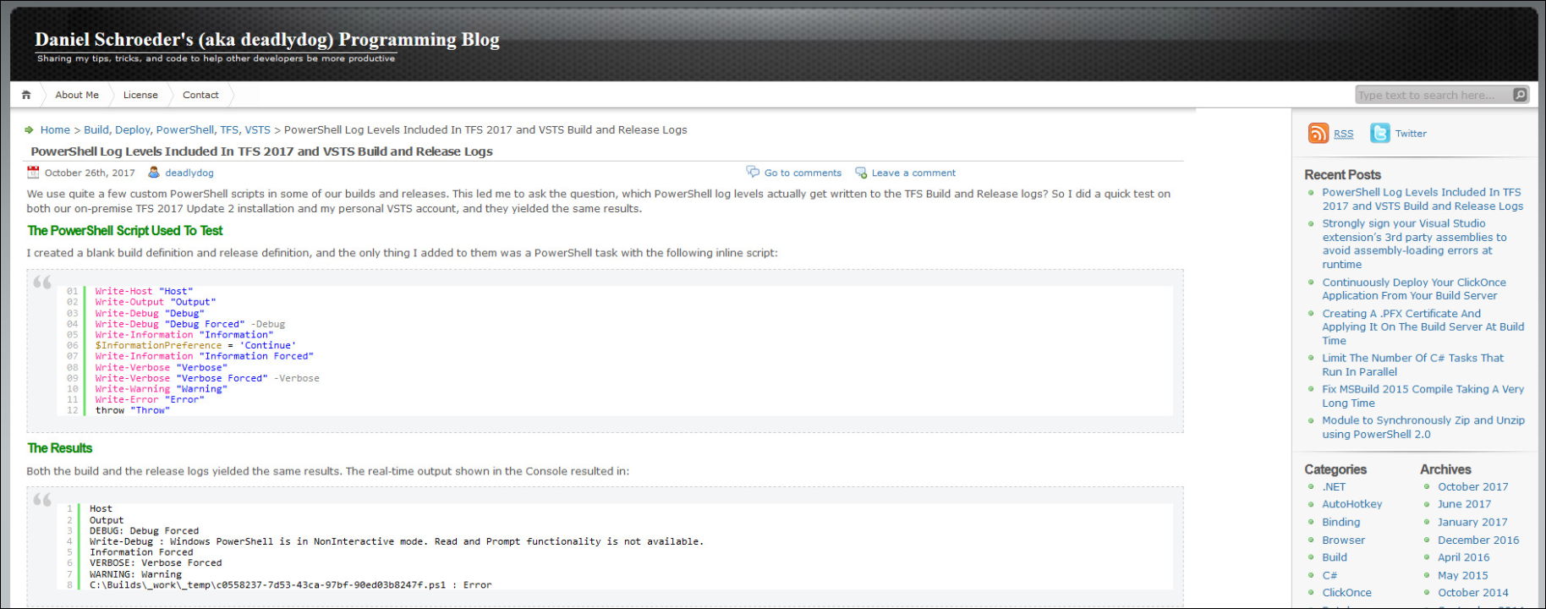
Notes:
- This is what my blog looks like now
- and before 2020
- If either look familiar, then you’ve likely visited my blog before

Slide 5
Agenda
Why use modules?
Why automate publishing?
How to automate publishing?
Demo

Slide 6
Why use modules?
Easy to install
Easy to update
Easy to use
Notes:
- Install the module with a single command
- Don’t have to worry about where the script is stored
- Update to the latest version with a single command
- Don’t have to inspect script contents to ensure you have the latest version
- Call the cmdlets without worrying about where the script’s file path is

Slide 7
From scripts to modules
1. Run commands in terminal
2. Put commands into a script
3. Put Params on script
4. Turn script into a module
Migrating from scripts to modules is an iterative process
Not every script needs to be a module

Slide 8
Slide layout
Slides should be memes to exaggerate the point, then text afterward so the audience can see the point (accessibility, they can take pics, etc)
Put talking points in the Presenter Notes (even though won’t see them, will be useful for rehearsal and if I give the talk again later down the road)

Slide 9
Source Control
Using source control should be table stakes
Not using it is like still clicking through GUI wizards instead of scripting
Git, TFVC, subversion, whatever

Slide 10
Title

Slide 11
Recap
A list of all the reasons why to use pipelines

Slide 12



THANK YOU
Please review this session
twitter.com/deadlydog
github.com/deadlydog
blog.danskingdom.com

Slide 13
Heading

